Slide 1
Continuous Random Variable
A continuous random variable is such that any value (to any number of decimal places) within some interval is a possible value.
Heights of individuals
Time to finish a test
Hours spent exercising last week

Slide 2
Natural: human height, temperature, blood pressure
Man Made: machined products
For these measure, the average tends to be more frequent while values away from the mean are less frequent

Slide 3
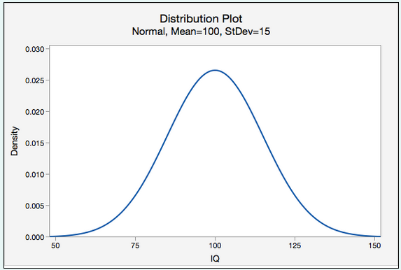
Normal Random Variables
A symmetric bell-shaped density function.
The distribution of IQ scores is normal
The total area under the curve is 1.00, or 100%.
In other words, 100% of observations fall under the curve.

Slide 4
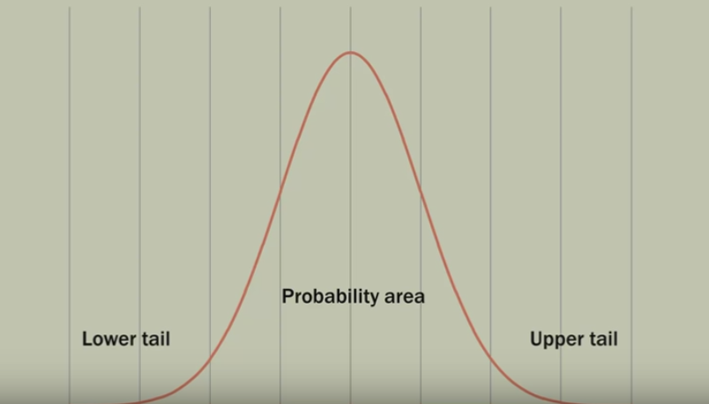

Slide 5
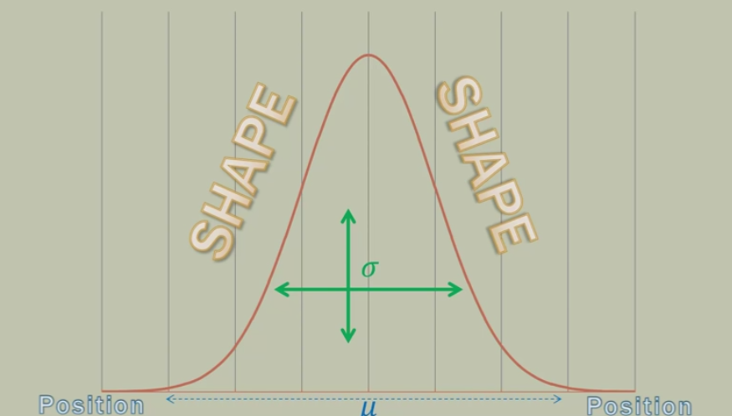

Slide 6
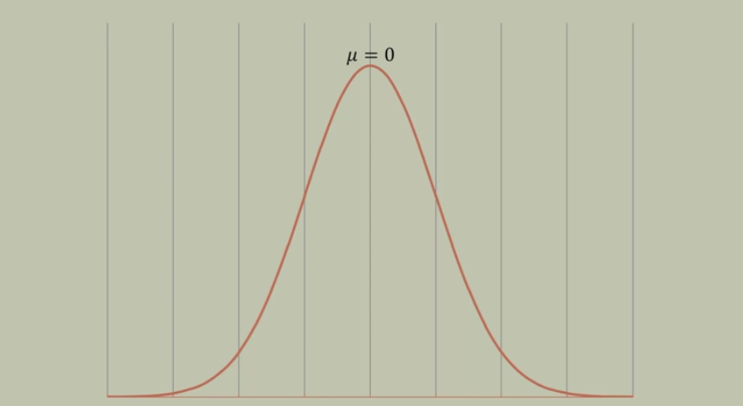
µ can be any numerical value
Slides distribution side to side

Slide 7
This becomes very very important when you are trying to determine the two population/sample are statistically different or not.

Slide 8
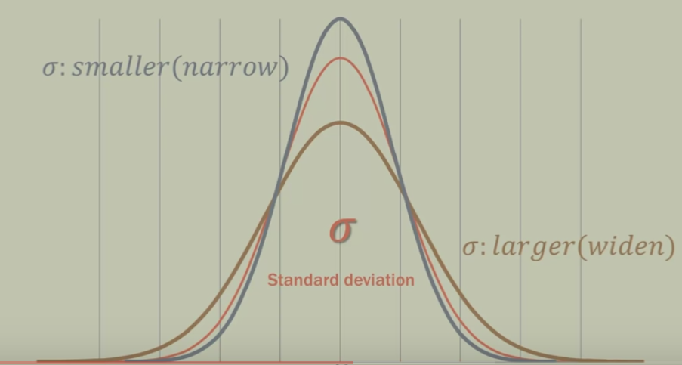

Slide 9
probability that the IQ of a randomly selected individual will be less than 115

Slide 10
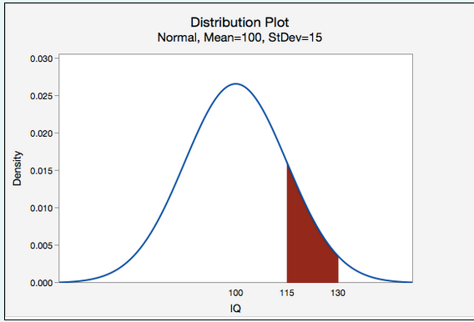
probability that the IQ of a randomly selected individual will be between 115 and 130

Slide 11
Scenario: Vehicle speeds at a highway location have a normal distribution with a mean of 65 mph and a standard deviation of 5 mph.
Question: What is the probability that a randomly selected vehicle will be going 73 mph or slower?

Slide 12
probability that a randomly selected vehicle speed is greater than 73

Slide 13
Suppose pulse rates of adult females have a normal curve distribution with mean of 75 and a standard deviation of 8. What is the probability that a randomly selected female has a pulse rate greater than 85?

Slide 14
The lifetime of a battery is normally distributed with a mean life of 40 hours and a standard deviation of 1.2 hours. Find the probability that a randomly selected battery lasts longer than 42 hours.

Slide 15

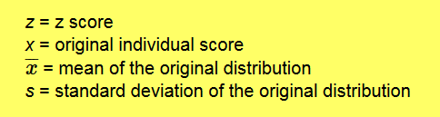
Standard Normal distribution

Slide 16
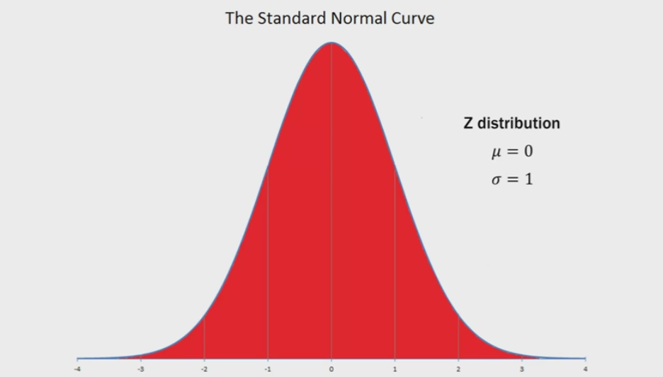

Slide 17
Area under the curve is 1

Slide 18
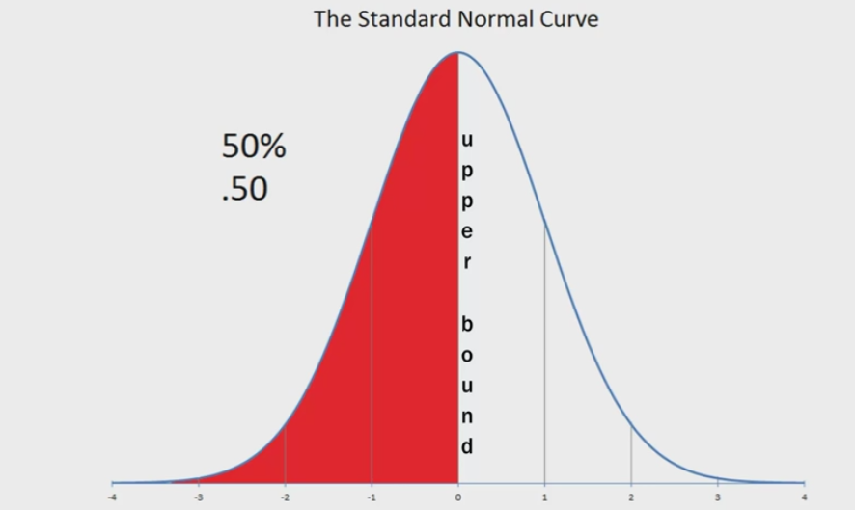

Slide 19
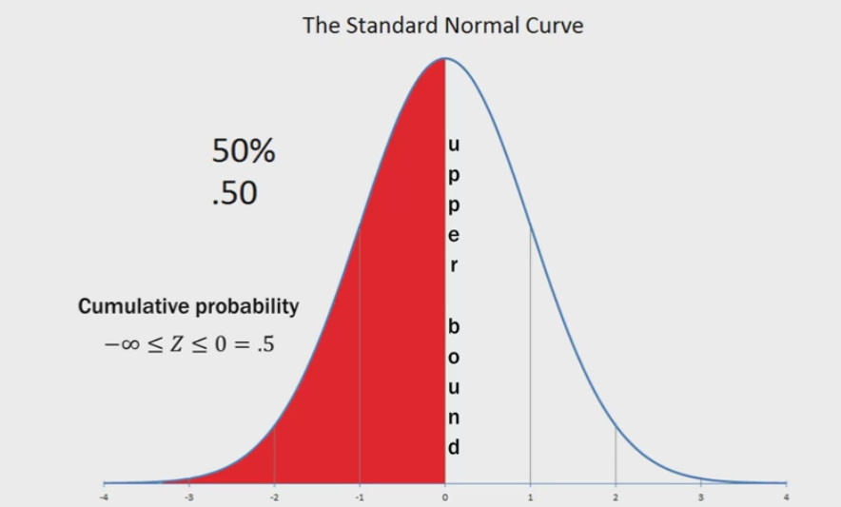

Slide 20
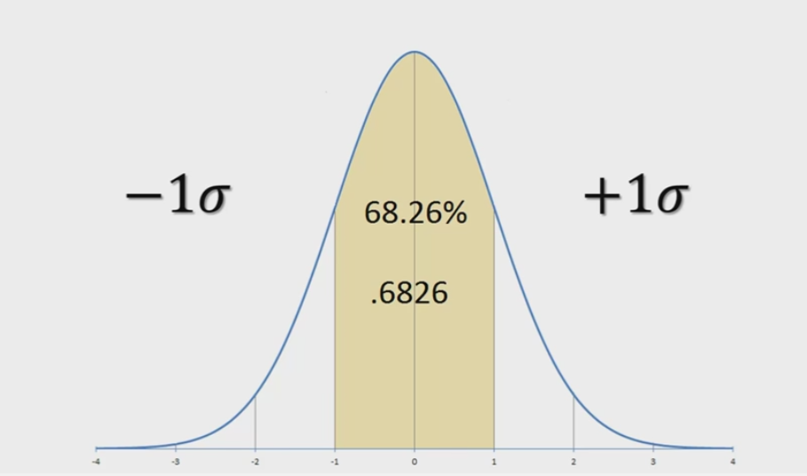

Slide 21
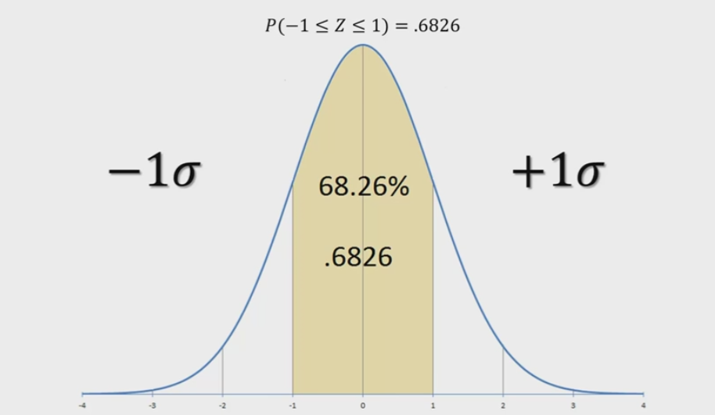

Slide 22
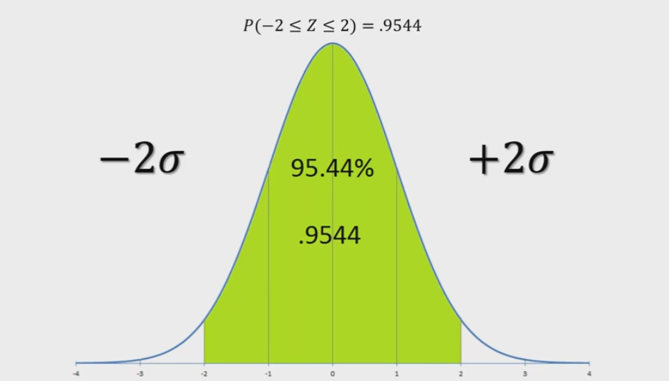

Slide 23
In statistics we use 95% confidence interval that is exactly -1.96 to +1.96.

Slide 24
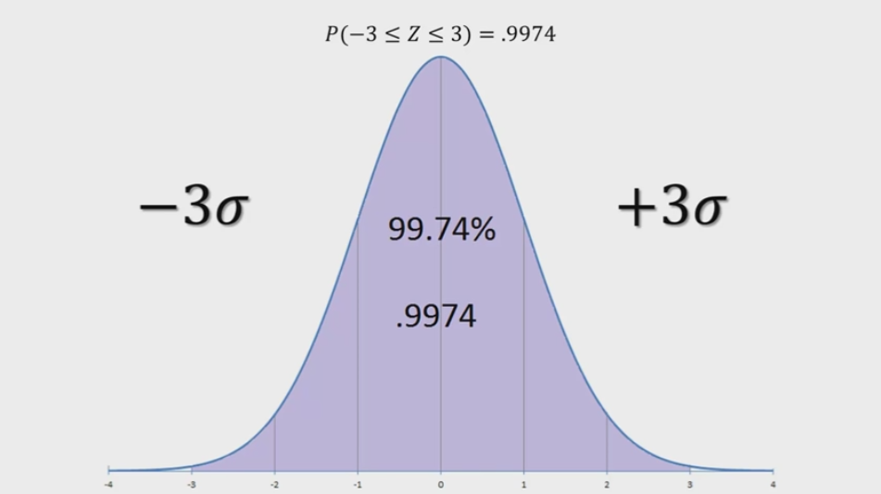

Slide 25
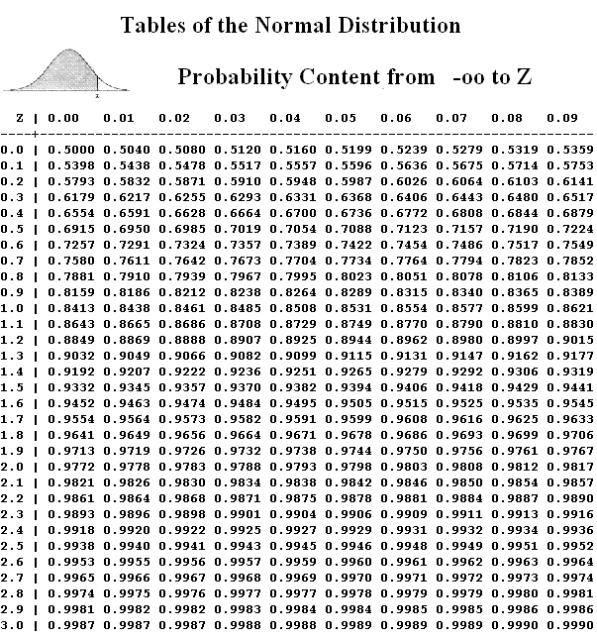

Slide 26
Consider taking two random samples, each sample consisting of 5 students,
from a class and calculating the mean height in each sample. Would you expect both sample means to be exactly the same?

Slide 27
No, the two sample means would be different because of random sampling error.
If you were to repeatedly pull samples of 5 students from the population of all students and compute the mean of each sample, you could construct a distribution of sample means.

Slide 28
Sampling Distribution
The distribution of the values of sample statistic computed for each possible sample drawn from target population.

Slide 29
Sampling Distribution
The distribution of the values of sample statistic computed for each possible sample drawn from target population.

Slide 30
Sampling Distribution
The distribution of the values of sample statistic computed for each possible sample drawn from target population.
It is used estimate the population parameter

Slide 31
Statistics
Mean of mean of sampling distribution
Standard deviation of mean of sampling distribution

Slide 32
Central Limit Theorem
With a sample size of at least 30, the distribution of sample means will be approximately normally distributed regardless of the shape of the population with a mean of μ and a standard deviation of sigma/root(n). This is known as the Central Limit Theorem.

Slide 33
In the population, IQ scores are normally distributed with a mean of 100 and standard deviation of 15. If we repeatedly pulled random samples of 25 individuals from the population and measured their IQ, what proportion of those samples would we expect to have a sample mean between 95 and 105?

Slide 34
The height of women in the United States is normally distributed with a mean of 163cm and standard deviation of 6cm. What is the probability that you would randomly select one woman in the United States and she is taller than 169cm?
The height of women in the United States is normally distributed with a mean of 163cm and standard deviation of 6cm. What is the probability that you would randomly select a sample of n=50 women in the United States and their average height is greater than 169cm?

Slide 35
According to one source, newborn baby weights have a mean of 7.5 pounds with a standard deviation of 1.1 pounds.
If these numbers are accurate, what proportion of samples of n=50 would have a sample mean greater than 8 pounds?

Slide 36
In Article published, the population of all World Campus students 49.2% were female.
Wanted to check whether it is actually true.
He obtains a random sample of 50 students. In his random sample there were 28 females and 22 males.
If the population from which her sample was drawn really is 49.2% female, what is the probability that she would take a random sample of 50 students and find that 28 or more are females?

